Slide 1
Wednesday, August 31, 2016
Write In Your Agenda:
Write In Your Monitoring Log:
CW:
Begin Convection Currents Lab
-demo
-problem
-research
-hypothesis
HW:
Study for quiz on Friday 9/2
Response to Warm-Up:
What is a current?
(HINT: Think water or air)
You will need:
Pencil
Hand in “Falling through the Earth” story

Slide 2
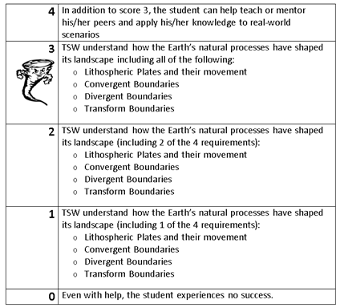
Learning Goal and Scale
TSW understand how the Earth’s natural processes have shaped its landscape (including Lithospheric Plates and their movement, Convergent, Divergent, and Transform boundary landforms).

Slide 3
https://www.youtube.com/watch?v=jkKlGXG4lG8

